Slide 1
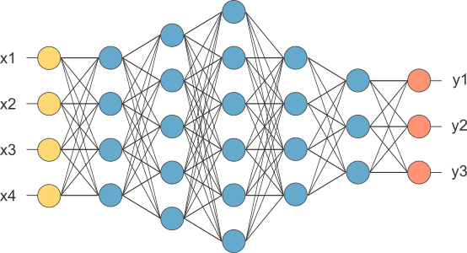
Lecture 6 Smaller Network: RNN
This is our fully connected network. If x_{1 .}... x_{n}, n is very large and growing,
this network would become too large. We now will input one x_{i} at a time,
and re-use the same edge weights.

Slide 2
Problems with naive RNN
When dealing with a time series, it tends to forget old information. When there is a distant relationship of unknown length, we wish to have a “memory” to it.
Vanishing gradient problem.

Slide 3
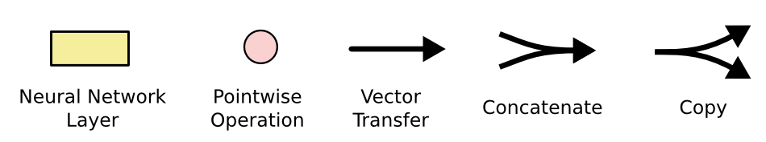
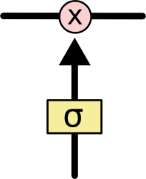
The sigmoid layer outputs numbers between 0-1 determine how much
each component should be let through. Pink X gate is point-wise multiplication.

Slide 4
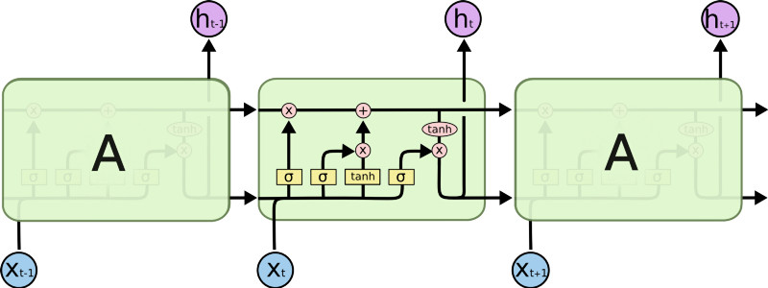
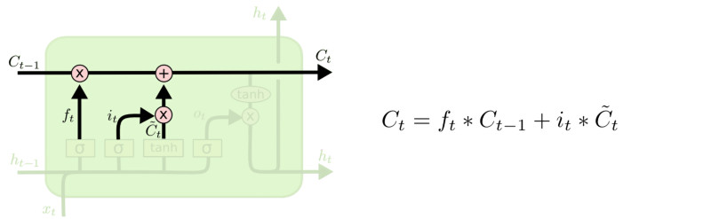
LSTM
Output gate
Controls what
goes into output
This sigmoid gate
determines how much
information goes thru
This decides what info
Is to add to the cell state
C_{t-1}
h_{t-1}
Forget input
gate gate
The core idea is this cell state C_{t}, it is changed slowly, with only minor linear interactions. It is very easy for information to flow along it unchanged.
Why sigmoid or tanh:
Sigmoid: 0,1 gating as switch.
Vanishing gradient problem in
LSTM is handled already.
ReLU replaces tanh ok?

Slide 5
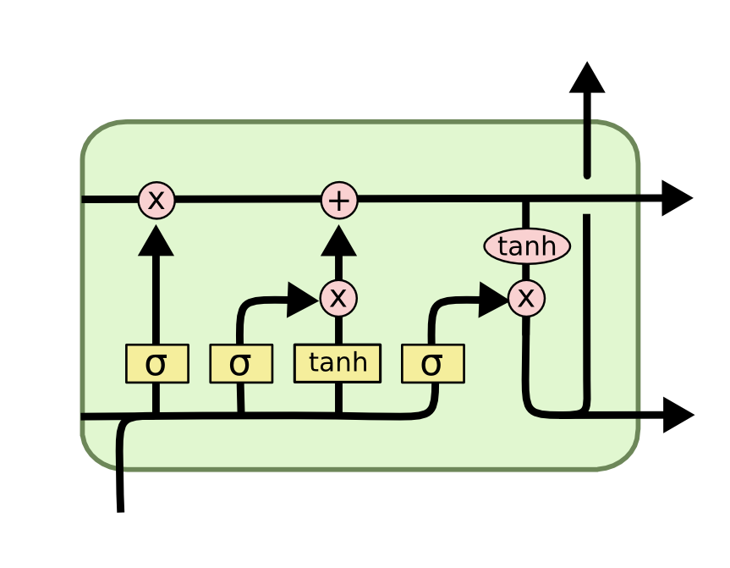
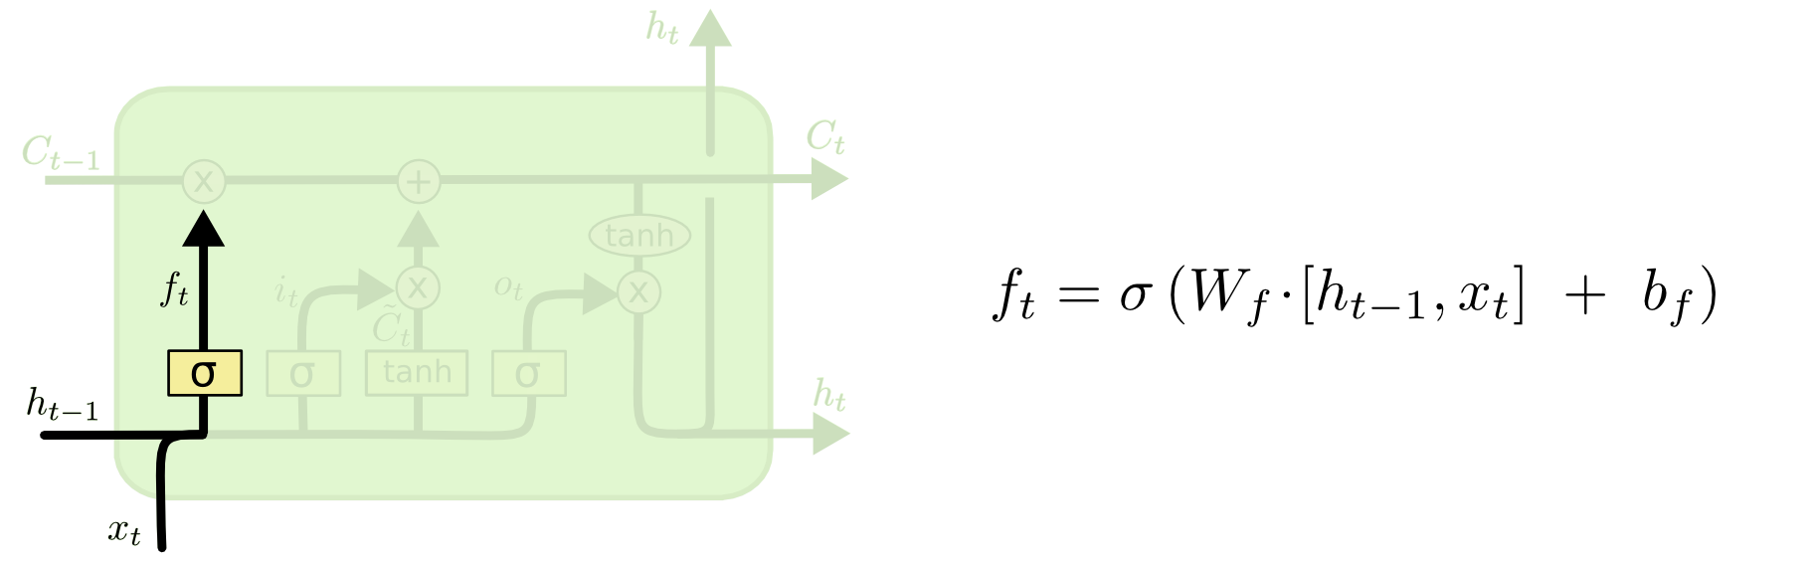
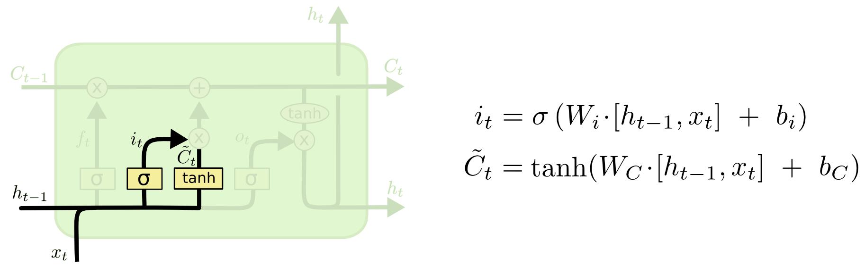
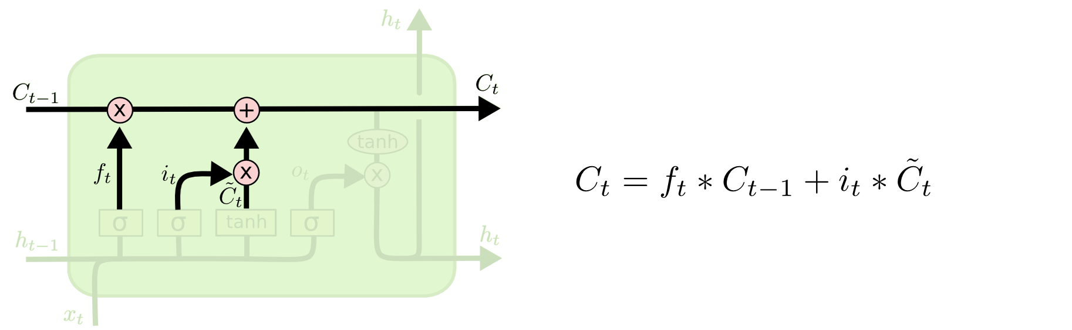
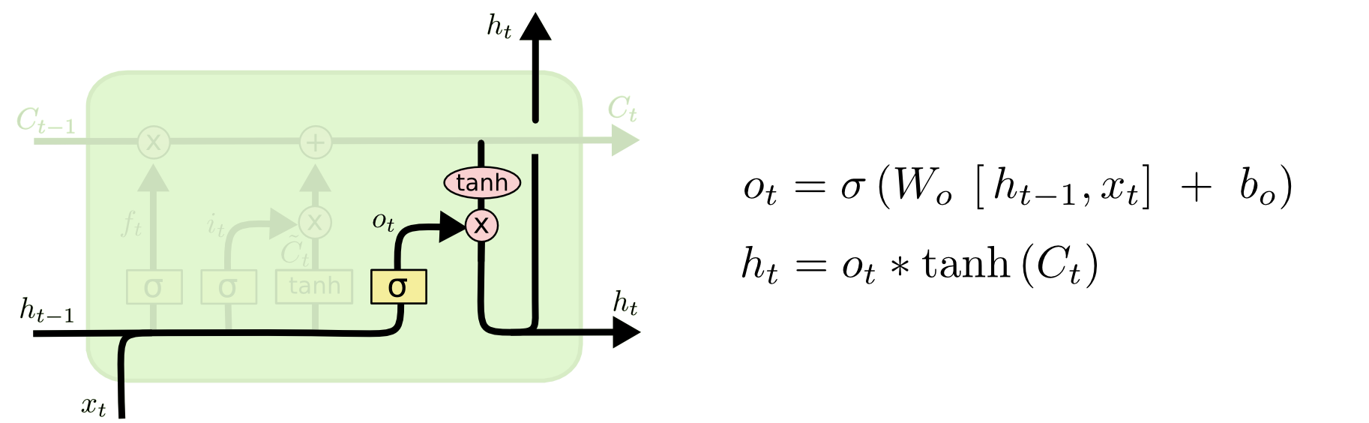
i_{t} decides what component
is to be updated.
C’_{t} provides change contents
Updating the cell state
Decide what part of the cell
state to output

Slide 6
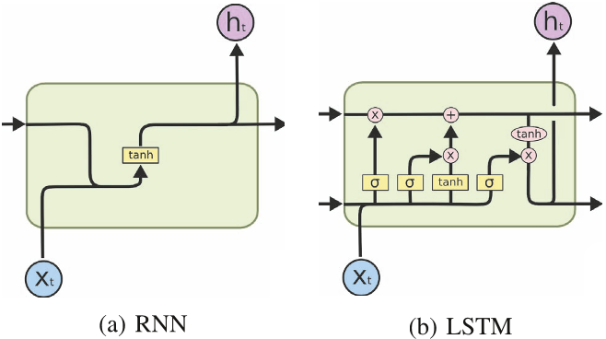
RNN vs LSTM

Slide 7
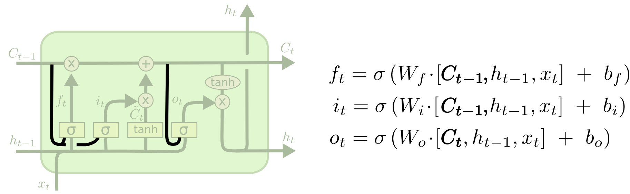
Peephole LSTM
Allows “peeping into the memory”

Slide 8
Naïve RNN vs LSTM
y^{t}
LSTM
c^{t}
y^{t}
c^{t-1}
Naïve
RNN
h^{t}
h^{t}
h^{t-1}
h^{t-1}
x^{t}
x^{t}
c changes slowly
c^{t} is c^{t-1} added by something
h changes faster
h^{t} and h^{t-1} can be very different

Slide 9
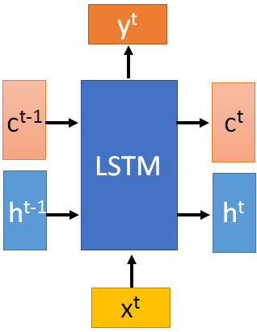

These 4 matrix
computation should
be done concurrently.
x^{t}
z
W
h^{t-1}
c^{t-1}
x^{t}
z^{i}
W^{i}
= σ( )
h^{t-1}
Controls
forget gate
Controls
input gate
Updating
information
Controls
Output gate
W^{f}
x^{t}
z^{f}
= σ( )
h^{t-1}
z^{f}
z^{i}
z
zº
x^{t}
zº
Wº
= σ( )
h^{t-1}
x^{t}
h^{t-1}
Information flow of LSTM

Slide 10
x^{t}
z
W
h^{t-1}
=tanh( )
c^{t-1}
c^{t-1}
diagonal
“peephole”
zº
z^{f}
z^{i}
obtained by the same way
z^{f}
z^{i}
z
zº
h^{t-1}
x^{t}
Information flow of LSTM

Slide 11




Element-wise multiply
y^{t}
c^{t-1}
c^{t}
c^{t} = z^{f}  c^{t-1} + z^{i}z
tanh
h^{t} = zº  tanh(c^{t})
y^{t} = σ(W’ h^{t})
z^{f}
z^{i}
z
zº
h^{t-1}
x^{t}
h^{t}
Information flow of LSTM

Slide 12



LSTM information flow
y^{t}
y^{t+1}
c^{t-1}
c^{t}
c^{t+1}
tanh
tanh
z^{f}
z^{i}
z
zº
z^{f}
z^{i}
z
zº
h^{t+1}
h^{t-1}
x^{t}
h^{t}
x^{t+1}
Information flow of LSTM

Slide 13
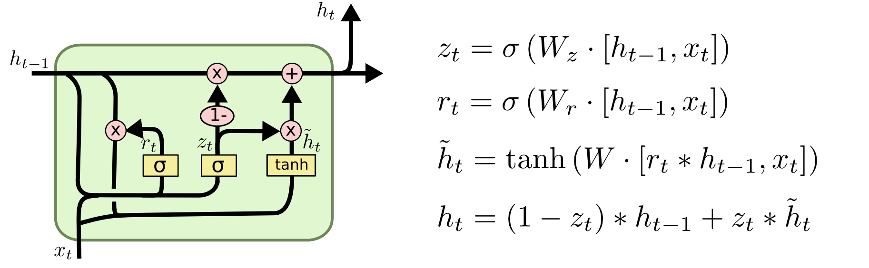
GRU – gated recurrent unit (more compression)
LSTM
reset gate
Update gate
It combines the forget and input into a single update gate.
It also merges the cell state and hidden state. This is simpler
than LSTM. There are many other variants too.
X,*: element-wise multiply

Slide 14
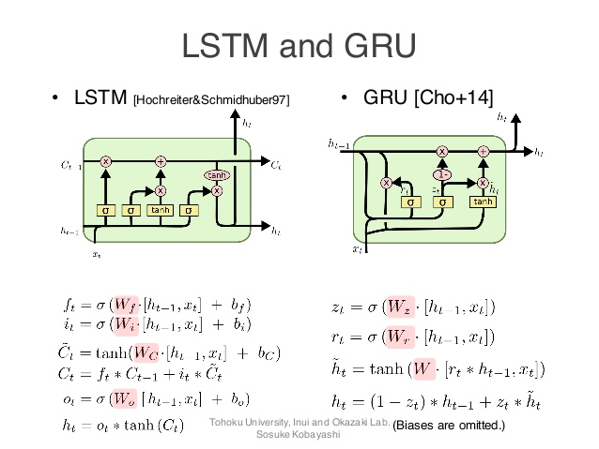
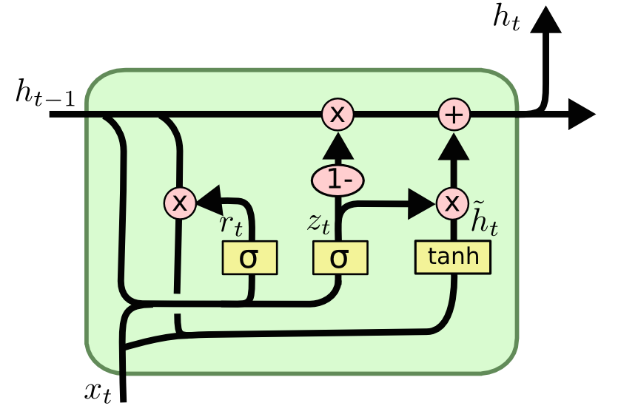
GRUs also takes x_{t} and h_{t-1} as inputs. They perform some calculations and then pass along h_{t}. What makes them different from LSTMs is that GRUs don't need the cell layer to pass values along. The calculations within each iteration insure that the h_{t} values being passed along either retain a high amount of old information or are jump-started with a high amount of new information.

Slide 15
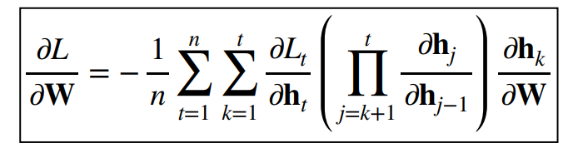
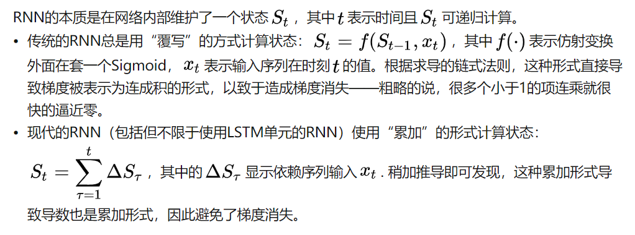
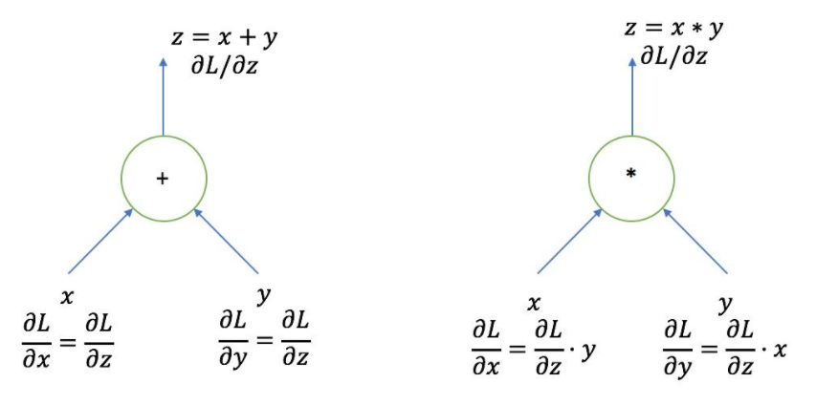
Why LSTM can alleviate vanishing gradient?
Vanilla RNN
LSTM

